Slide 1
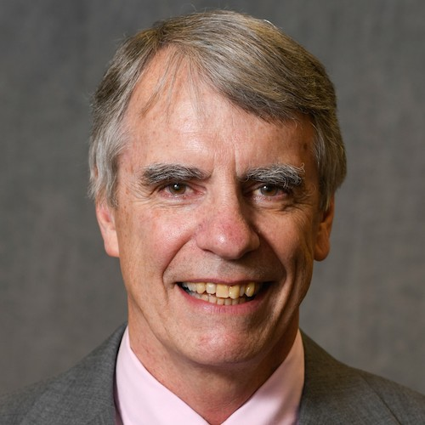


Congratulations to Dr. Leonard A. Stefanski: Newly Declared Institute of Mathematical Statistics Fellow

