Slide 1
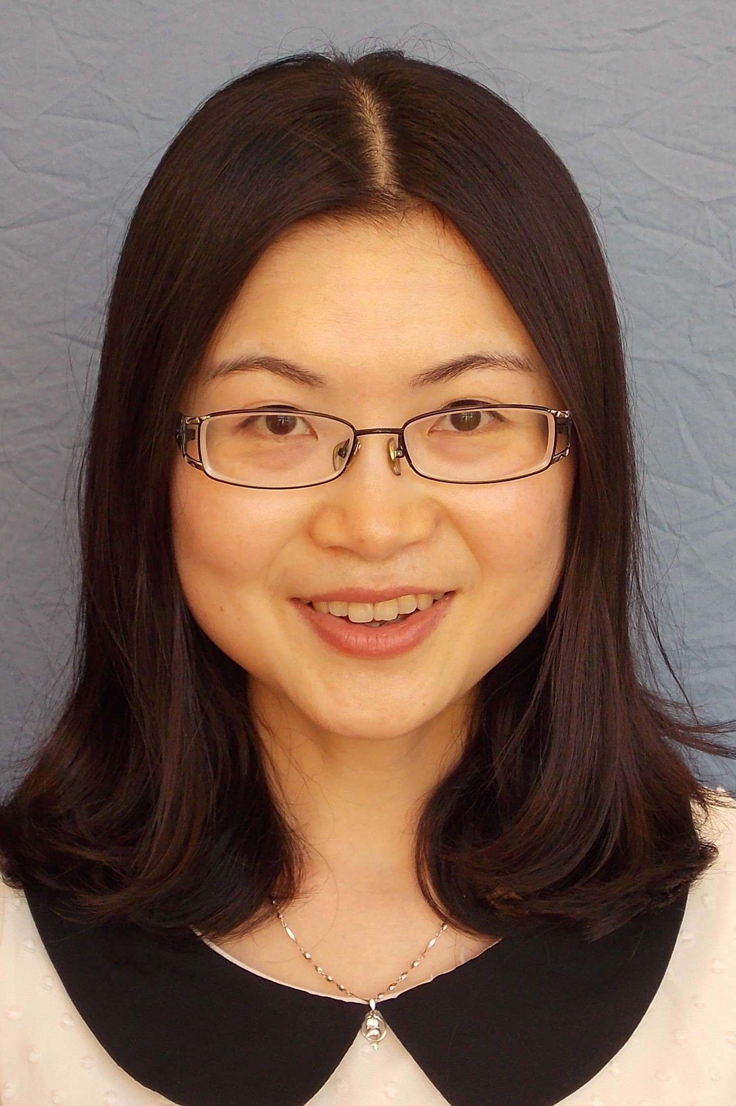

Congratulations to
Dr. Shu Yang
She has won the Ralph E. Powe Junior Faculty Enhancement Award! The award provides funding for research by junior faculty at Oak Ridge Associated Universities. These awards enrich the research and professional growth of young faculty and result in new funding opportunities.
Notes:
To customize a template, choose a background color from NC State’s core color palette. The expanded palette colors are also available in swatches within the template, but do not use these against Wolfpack Red. Adjust the elements to best fit your content, write short copy that can be read quickly at a distance and then save the finished slide as a JPG or PNG of at least 1920x1080 pixels.

