Slide 1
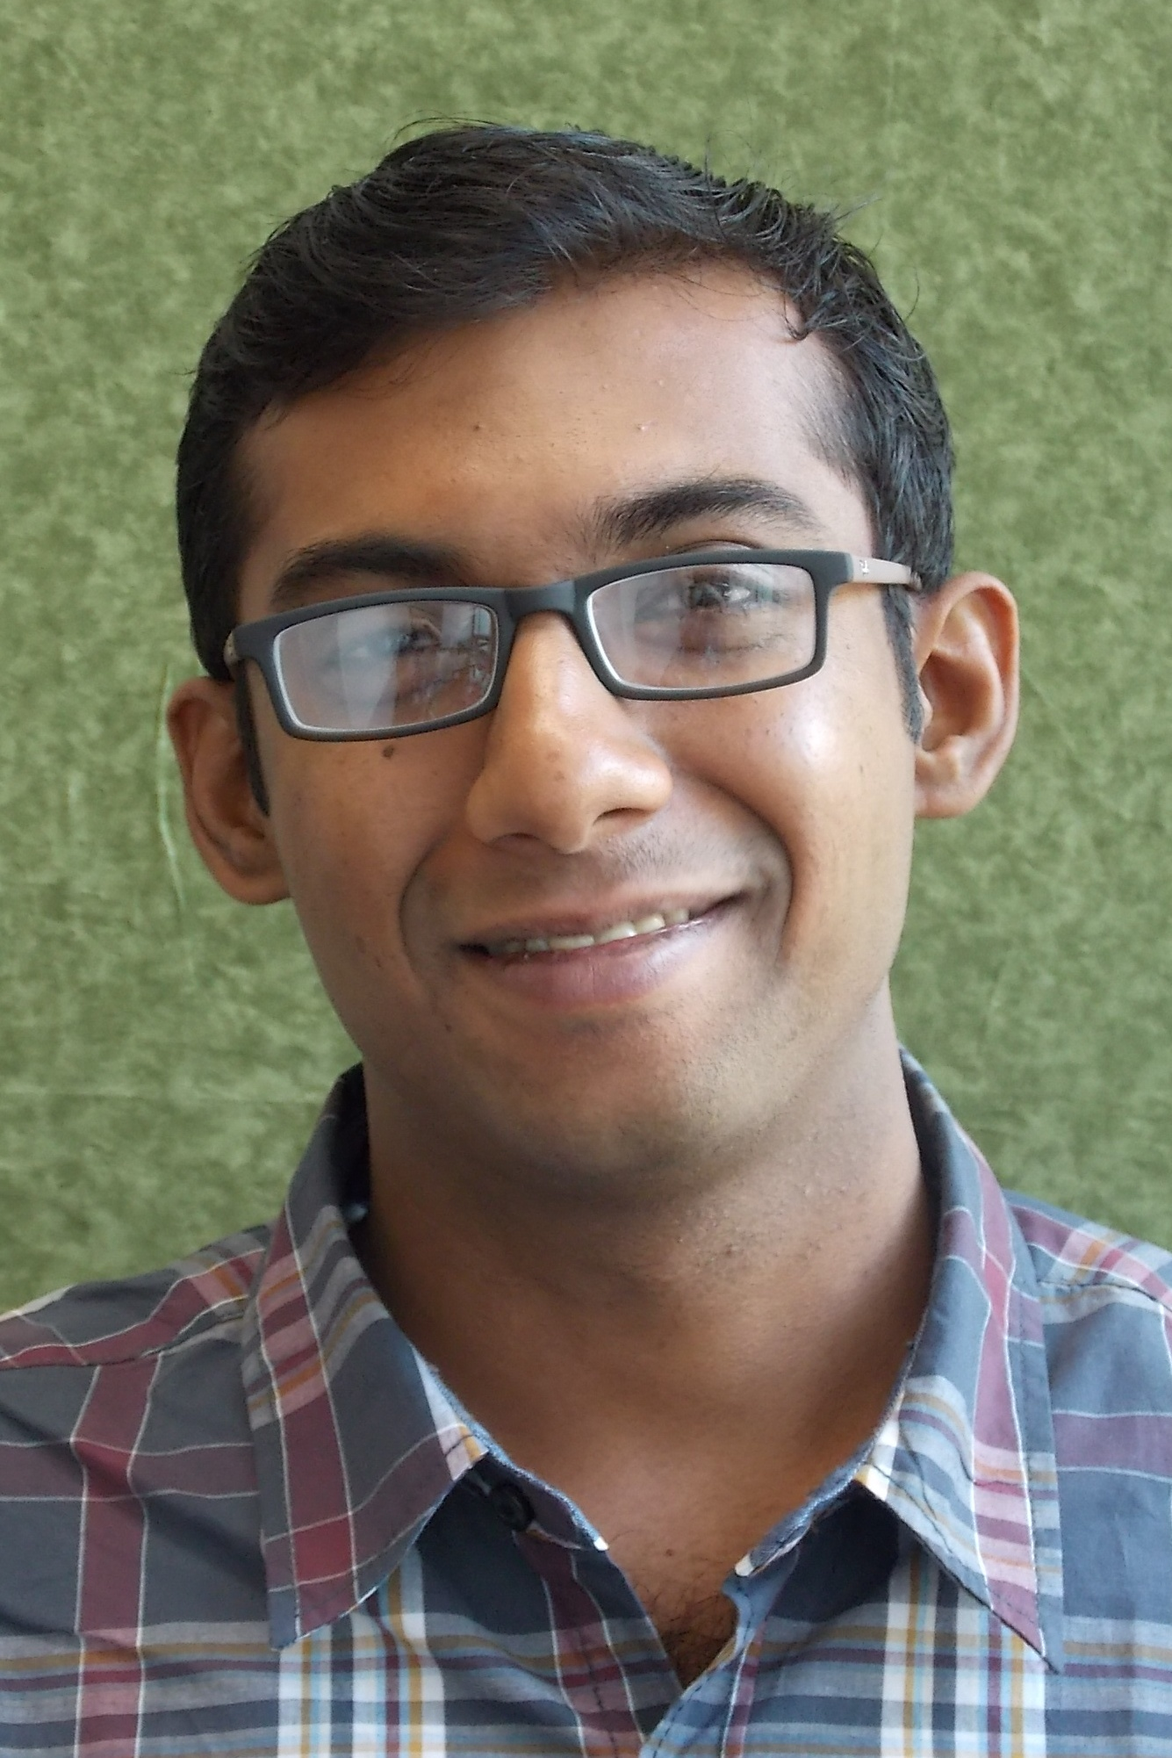
Congratulations to Dr. Md Nazmul Islam
He successfully defended his dissertation "Functional Data Analysis with Applications in Animal Science and Biomedical Engineering"
May 9, 2018
Advisors: Jon Stallrich and Ana-Maria Staicu
Department of Statistics, College of Sciences
Notes:
To customize a template, choose a background color from NC State’s core color palette. The expanded palette colors are also available in swatches within the template, but do not use these against Wolfpack Red. Adjust the elements to best fit your content, write short copy that can be read quickly at a distance and then save the finished slide as a JPG or PNG of at least 1920x1080 pixels.

