Slide 1
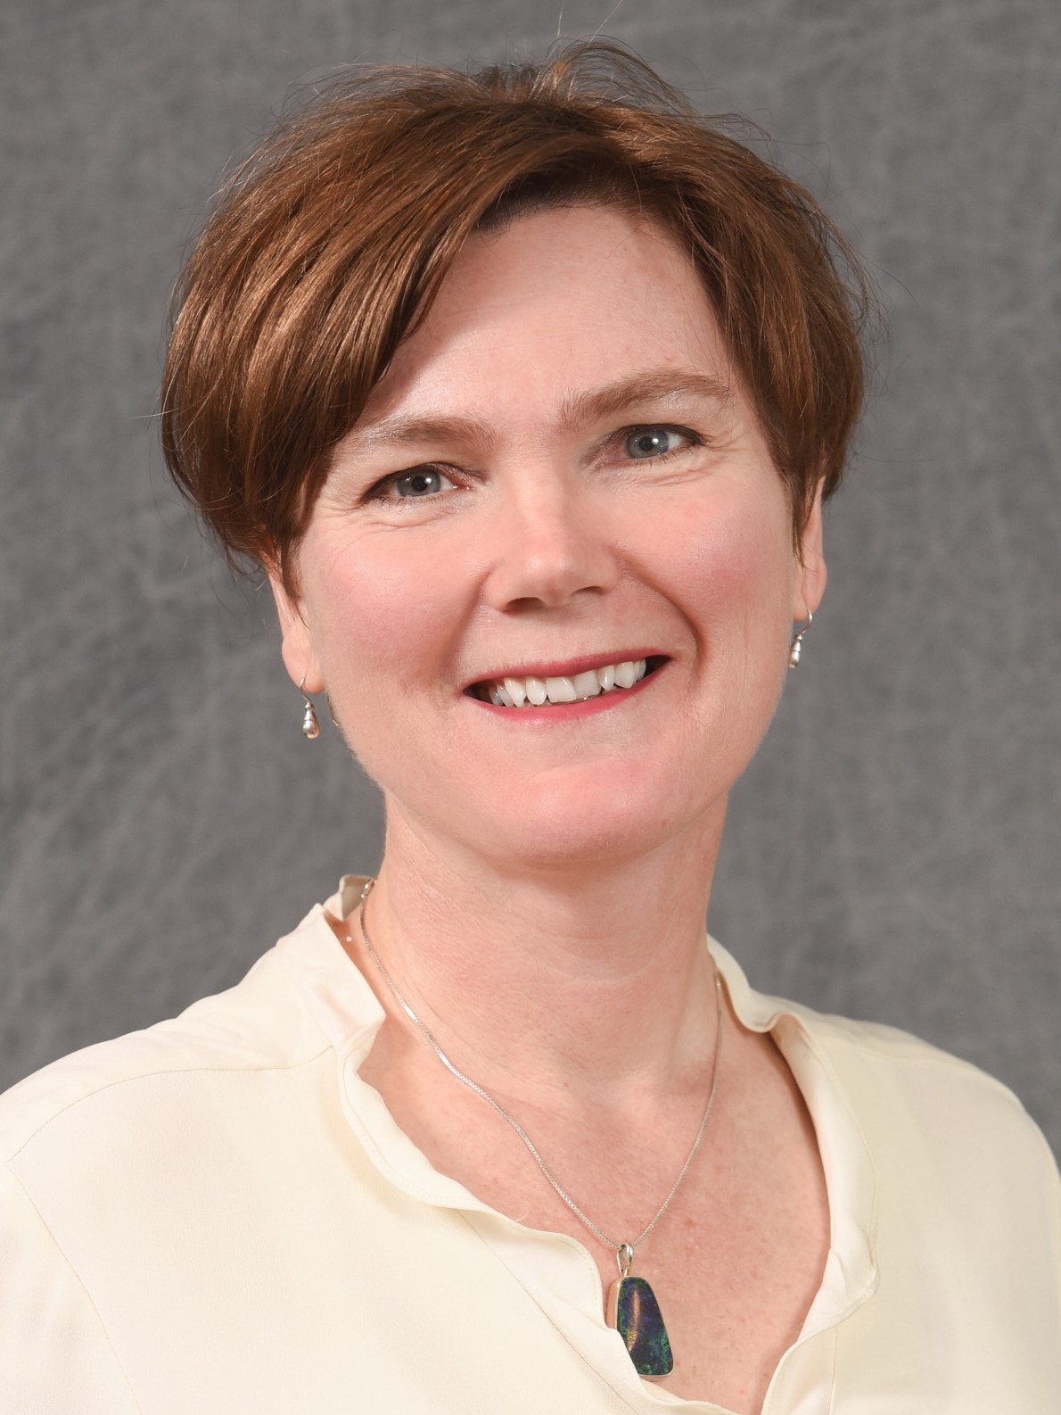

Dr. Shannon Holloway, Senior Research Scholar, has received the University-wide Award for Excellence. The award recognizes her exceptional contributions to the NIH P01 Program Project as Director of its Computational Resource Core and her outstanding mentoring of students and junior faculty in the Department on research, communication, and grantsmanship skills.
Congratulations Shannon!
Notes:
To customize a template, choose a background color from NC State’s core color palette. The expanded palette colors are also available in swatches within the template, but do not use these against Wolfpack Red. Adjust the elements to best fit your content, write short copy that can be read quickly at a distance and then save the finished slide as a JPG or PNG of at least 1920x1080 pixels.

