Slide 1
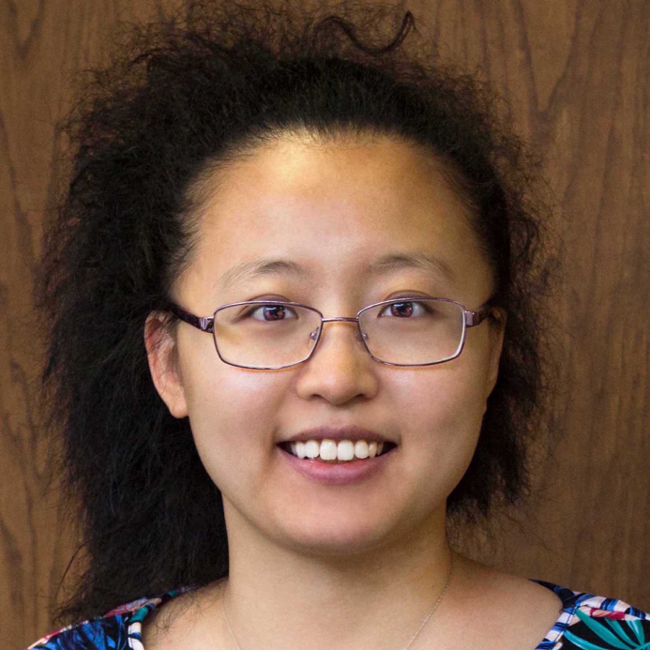
New Statistics Faculty
Dr. Shuting Wang
Dr. Shuting Wang comes to us from Texas Lutheran University as an assistant professor in the M.S. of Data Analytics program. Prior to that she was an assistant professor at State University of New York at Canton. She received her Phd from University of Illinois at Chicago. Her areas of interest include statistics education, financial analytics and time series analysis.
Notes:
To customize a template, choose a background color from NC State’s core color palette. The expanded palette colors are also available in swatches within the template, but do not use these against Wolfpack Red. Adjust the elements to best fit your content, write short copy that can be read quickly at a distance and then save the finished slide as a JPG or PNG of at least 1920x1080 pixels.

Slide 2
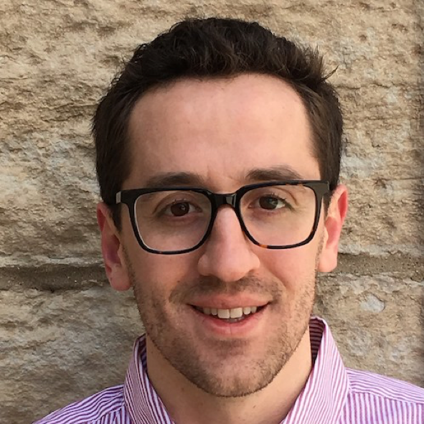
New Statistics Faculty
Dr. Jonathan Williams
Dr. Jonathan Williams comes to us from the University of North Carolina at Chapel Hill where he completed his PhD in the Department of Statistics and Operations Research. He also worked, and continues to maintain affiliation, as a Research Collaborator with the Mayo Clinic in Rochester, MN. His research interests include topics in foundations of statistics, methodology for medical science applications, and more recently, multivariate time-series analysis.
Notes:
To customize a template, choose a background color from NC State’s core color palette. The expanded palette colors are also available in swatches within the template, but do not use these against Wolfpack Red. Adjust the elements to best fit your content, write short copy that can be read quickly at a distance and then save the finished slide as a JPG or PNG of at least 1920x1080 pixels.

Slide 3
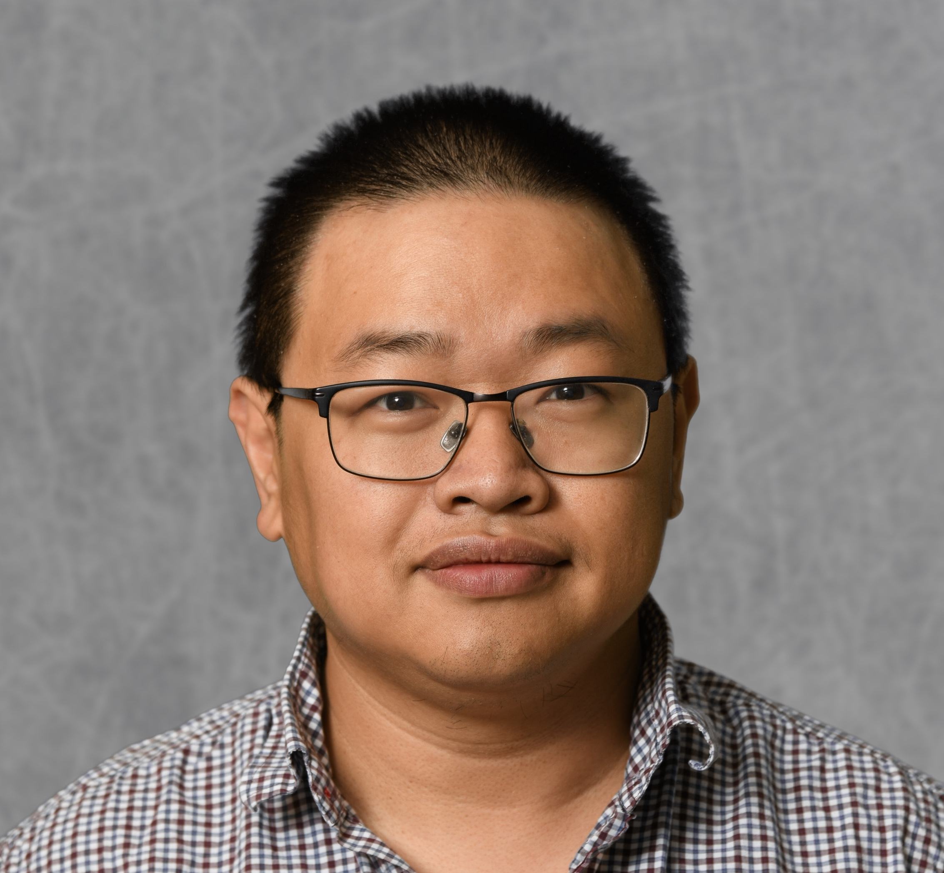
New Statistics Faculty
Dr. Minh Tang
Dr. Minh Tang comes to us from Johns Hopkins University where he was first a postdoctoral fellow then a research faculty in the department of Applied Mathematics and Statistics. He received his PhD in Computer Science from Indiana University in 2010. His research interests are in machine learning and statistical inference on graphs, with applications to neuroscience and social network analysis.
Notes:
To customize a template, choose a background color from NC State’s core color palette. The expanded palette colors are also available in swatches within the template, but do not use these against Wolfpack Red. Adjust the elements to best fit your content, write short copy that can be read quickly at a distance and then save the finished slide as a JPG or PNG of at least 1920x1080 pixels.

Slide 4
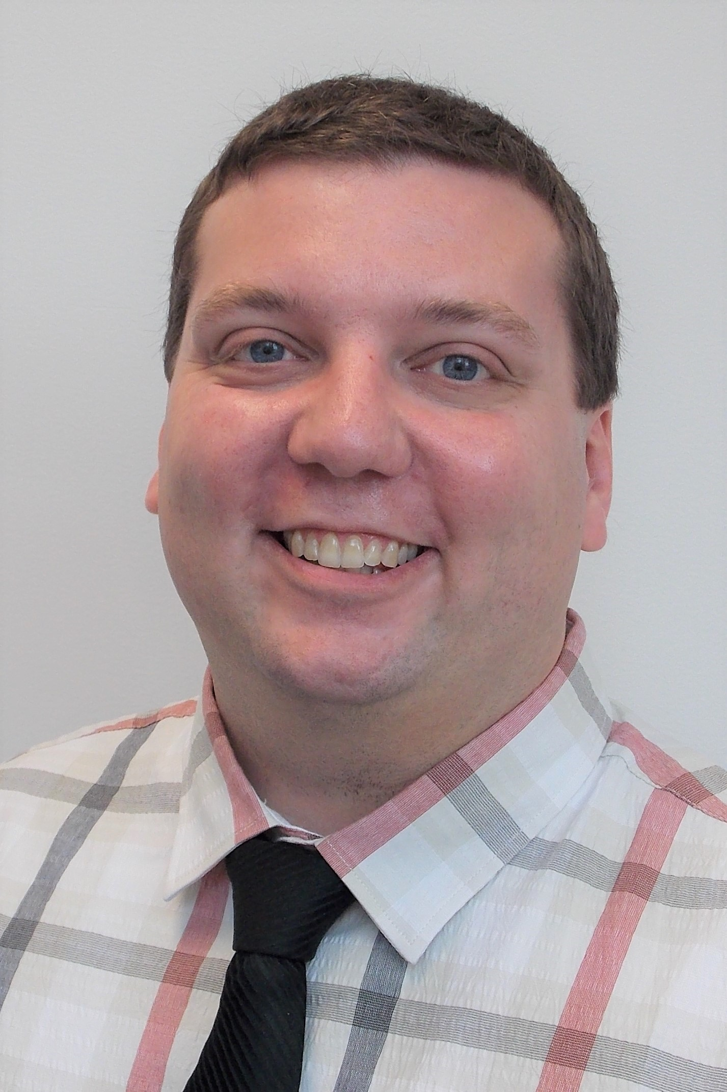
New Statistics Faculty
Dr. LOGAN OPPERMAN
Dr. Logan Opperman comes to us after graduating with his PhD in Statistics from Bowling Green State University in 2019. Prior to completing his degree, he was adjunct faculty for the University of Findlay and Owens Community College, both in Ohio, for a total of 6 years teaching experience in higher education. His areas of interest include goodness-of-fit tests, skewed distributions, statistics education and online learning.
Notes:
To customize a template, choose a background color from NC State’s core color palette. The expanded palette colors are also available in swatches within the template, but do not use these against Wolfpack Red. Adjust the elements to best fit your content, write short copy that can be read quickly at a distance and then save the finished slide as a JPG or PNG of at least 1920x1080 pixels.

Slide 5
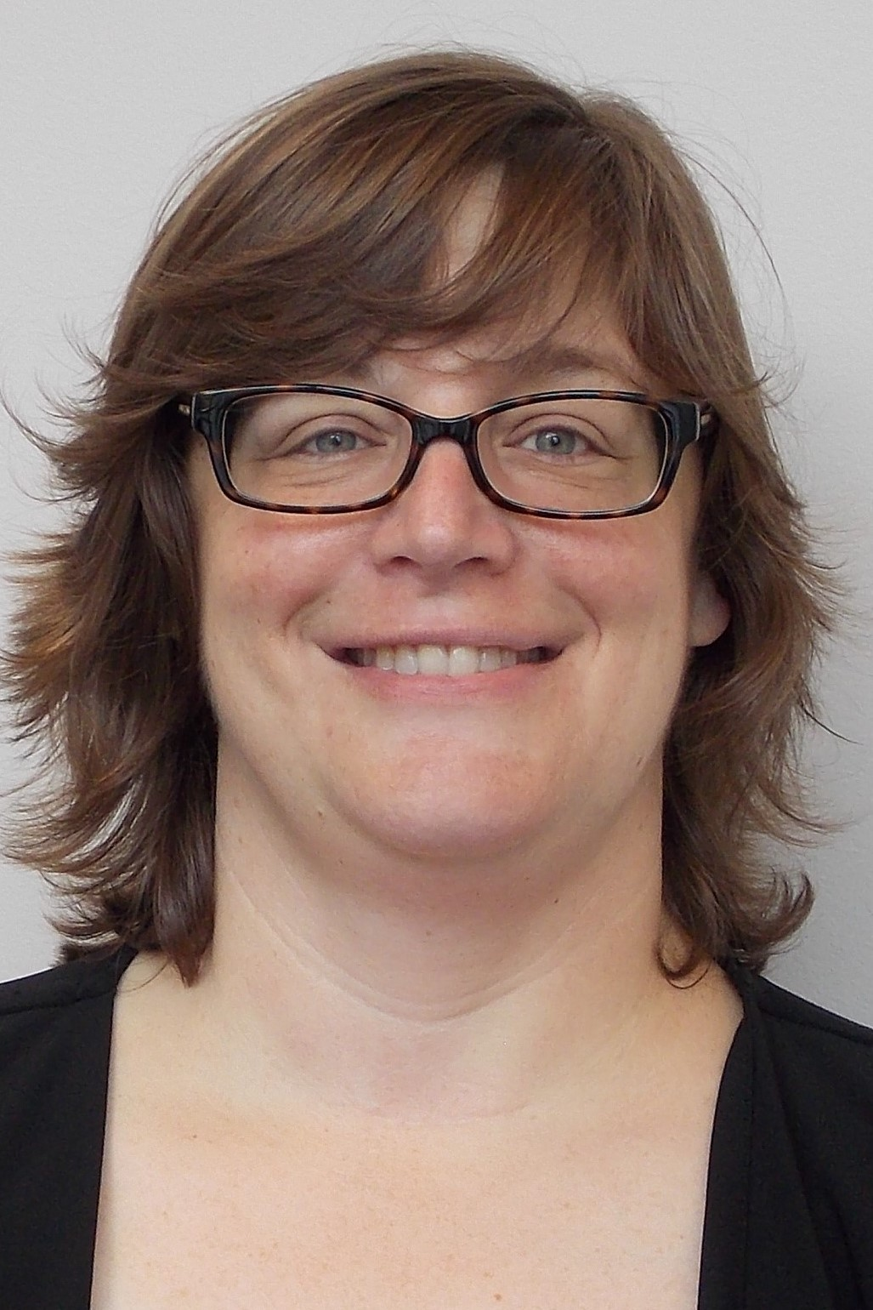
New Statistics STAFF
Aletta Davis
New Grant Proposal Administrator Aletta Davis has a BS and MS in Environmental Science with a focus on forest and ag soils. She worked for the US Forest Service and the USDA Soil Survey before coming to NCSU. She has been here at NCSU a little over 10 years, first as an MS level field/lab manager in the Forestry Dept, then in Pre-Awards for CNR, and then transferred to CALS Pre-Awards.
Notes:
To customize a template, choose a background color from NC State’s core color palette. The expanded palette colors are also available in swatches within the template, but do not use these against Wolfpack Red. Adjust the elements to best fit your content, write short copy that can be read quickly at a distance and then save the finished slide as a JPG or PNG of at least 1920x1080 pixels.

