Slide 1
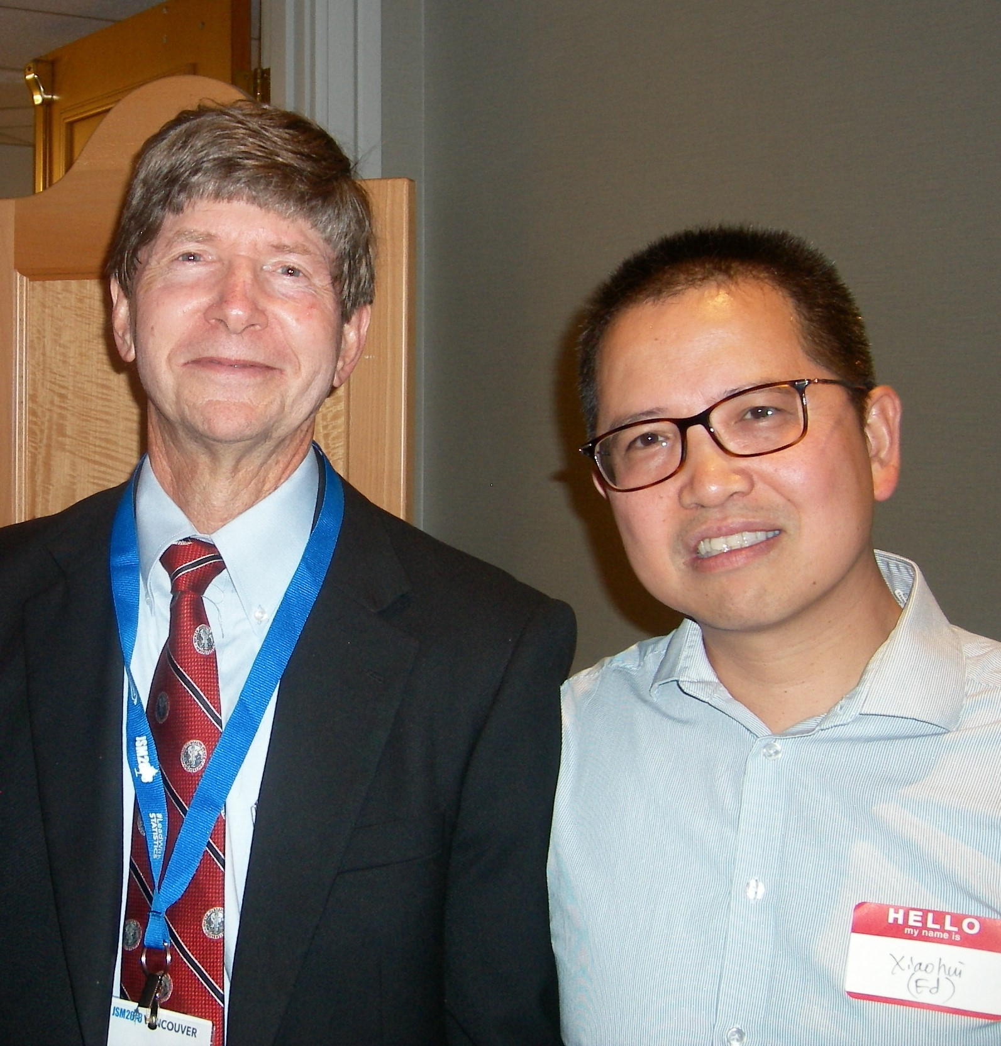

Dennis Boos Alumni Fund announced at JSM
Professor and Associate Department Head of Statistics Dennis Boos has been a pillar of the NC State statistics community for over 40 years.
In honor of Dr. Boos' career contributions to the Department and especially its graduate students, former graduate students Dr. Ed Luo '02 and Dr. Ji Zhang '90 established the Dennis D. Boos Alumni Fund to support students, faculty and programs in the Department of Statistics.
Notes:
To customize a template, choose a background color from NC State’s core color palette. The expanded palette colors are also available in swatches within the template, but do not use these against Wolfpack Red. Adjust the elements to best fit your content, write short copy that can be read quickly at a distance and then save the finished slide as a JPG or PNG of at least 1920x1080 pixels.

